Slide 1
Georgia Tech Facilities INC.
Project Management INTRO

Slide 2
What is a PPV?
What is GTFI?

Slide 3
Georgia TECH Facilities INC. What is a PPV?
A Public Private Venture or Partnership is a collaboration between BOR and a cooperative organization to efficiently provide facilities that do not require a direct financial investment by BOR.
BOR may ground lease property (land) to GTFI for the construction of new facilities, and/or BOR may lease properties from GTFI for use by the Institute.
Financing is re-paid by GTFI using revenues earned as rent from leasing completed project facility to Georgia Tech.
Buildings are gifted back to the BOR, typically within 35 years.

Slide 4
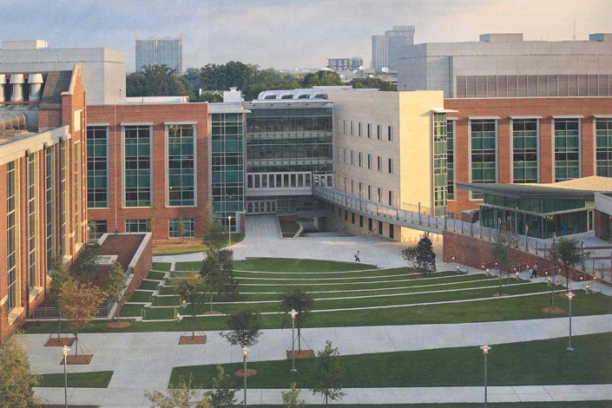
Georgia TECH Facilities INC. What is GTFI?
GTFI is a legally separate non-profit corporation that supports Georgia Tech by financing and developing facilities and other infrastructure for use by the Institute.
When GTFI collaborates with BOR on building projects, the relationship is considered a PPV.
By partnering with GTFI, the Institute is also able to take advantage of flexible solutions to address its strategic infrastructure goals.

Slide 5
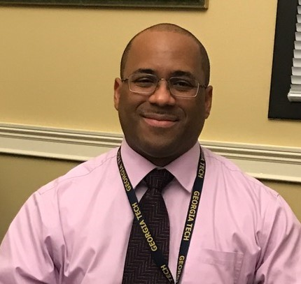
Georgia TECH Facilities INC. GTFI Leadership Team
GTFI Board of Directors – The GTFI Board of Directors provides leadership and oversight. The Board meets monthly for project briefing and financial updates.
Aisha Oliver-Staley – Executive Director
Jim Fortner – Treasurer
Kelly MacArthur – Assistant Treasurer
Jim Pierce – Assistant Treasurer
Jennifer Hubert – Corporate Secretary
Walter Johnson – Capital Financing and Compliance for GT (Supports GTFI and Affiliated Organizations)

Slide 6
Which Projects
go through GTFI?

Slide 7
Georgia TECH Facilities INC. Restricted PPV Building
Buildings owned by GTFI are leased back to BOR for use by GT. Some of the leases limit improvements that can be completed by GT (tenant).
For projects in these Restricted PPV Buildings, some renovation and improvement work must be run as a GTFI project if the project meets specific criteria.
The project needs to be reviewed during the planning phase and before funds are committed to determine if the project can be managed by GT as the tenant or if the project is required to be managed through GTFI.
The Facilities D&C Project Request Form (PRF) indicates if a project in a GTFI owned building with lease restrictions. (YES)

Slide 8
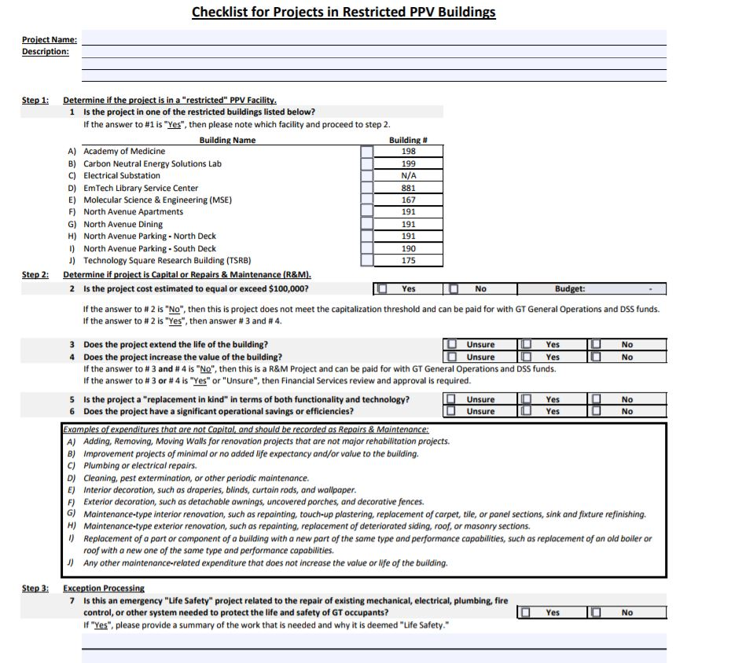
Georgia TECH Facilities INC. Restricted PPV Building
A checklist for projects in Restricted PPV Buildings must be completed and attached to the PRF.

Slide 9
Georgia TECH Facilities INC. RESTRICTED ppv building
Molecular Science and Engineering (167)
Technology Square Research Bldg - TSRB (175)
Electrical Substation – No Building #
North Ave Apartments + S. Parking Deck (190)
North Ave Apartments + N. Parking Deck + Dining Hall (191)
Carbon-Neutral Energy Solutions Laboratory – CNES (199)
EmTech Library Service Center (881)
The Living Building (project underway)
Dalney Deck (project underway)
GT Cobb Research Campus (project underway)

Slide 10
Georgia TECH Facilities INC. development funding
A project may be designated a GTFI project if there is a need for greater flexibility in executing a critical project (i.e. timeline, contracting, funding, etc.)
For example, flexible funding alternatives may include:
Private donations
Gifts or contributions from Affiliated organizations
Bond funds
Traditional loans

Slide 11
GTFI Project Process
It’s really different!!

Slide 12
Georgia TECH Facilities INC. DMSA OR Pmsa – Project GUIDE
A Development Management Services Agreement (DMSA) between GTFI and Facilities is executed for each development project (Major renovation or ground up construction.)
For recurring smaller projects in a GTFI owned building, a master or one time Project Management Services Agreement (PMSA) may be executed to cover all projects to be completed in a building.
The DMSA and PMSA establish roles and responsibilities as well as contracting signature authority.

Slide 13
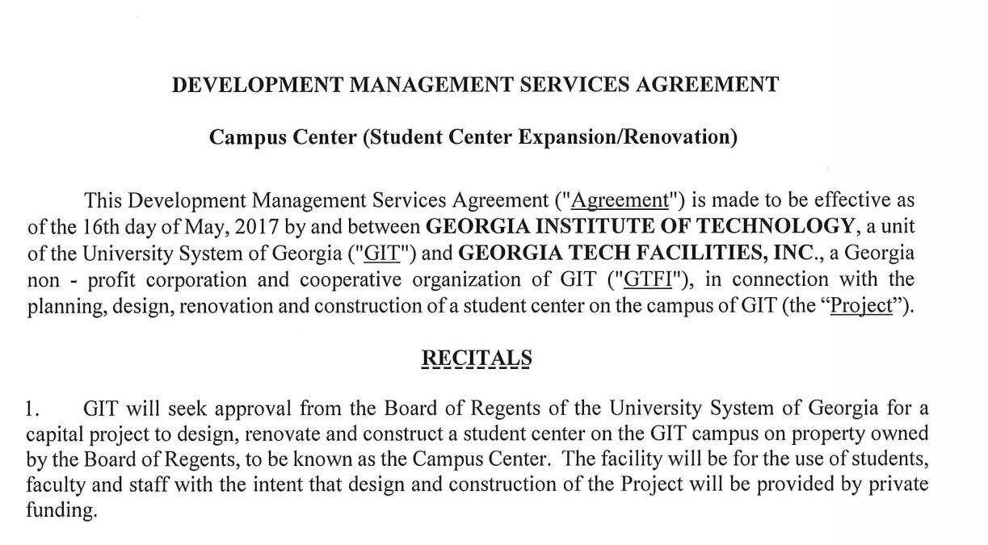
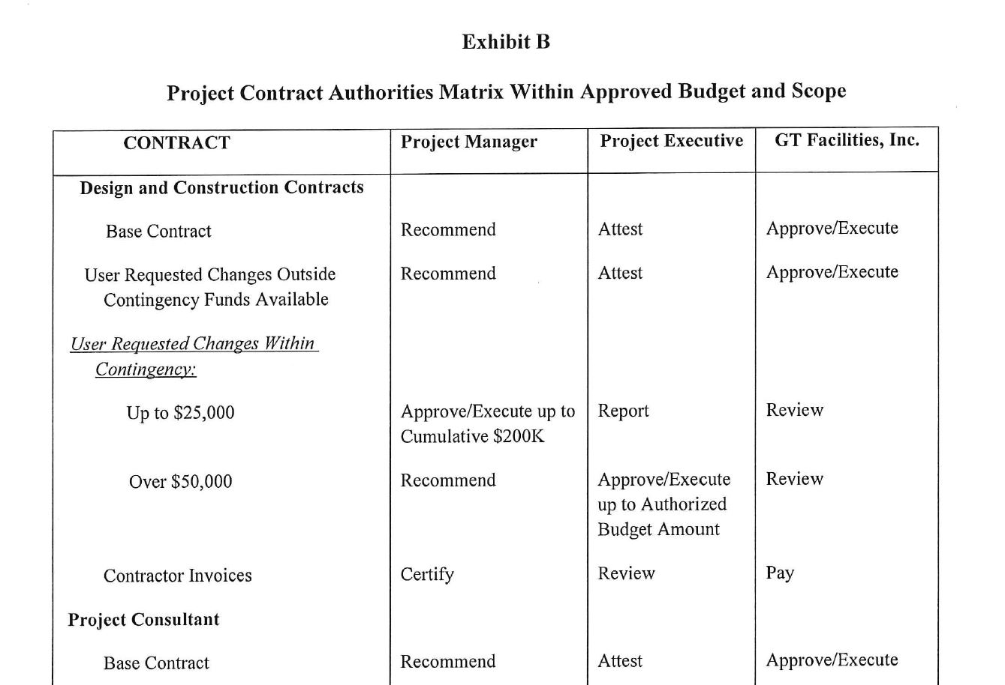
Georgia TECH Facilities INC. DMSA – Project MGMT AGREEMENT

Slide 14
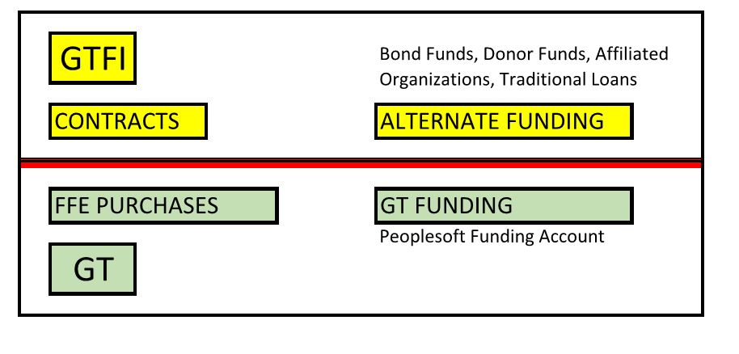
Georgia TECH Facilities INC. DMSA funding
GT PM manages CAP project on behalf of GTFI through a DMSA.
Contracts are held by GTFI.
GTFI pays invoices utilizing one or more designated funding sources, including bonds, traditional loans, donations, or contributions from affiliated organizations.
Funding is typically provided by GT for removable building contents such as furniture, AV, and FFE. (Items to be owned by the renter.)

Slide 15
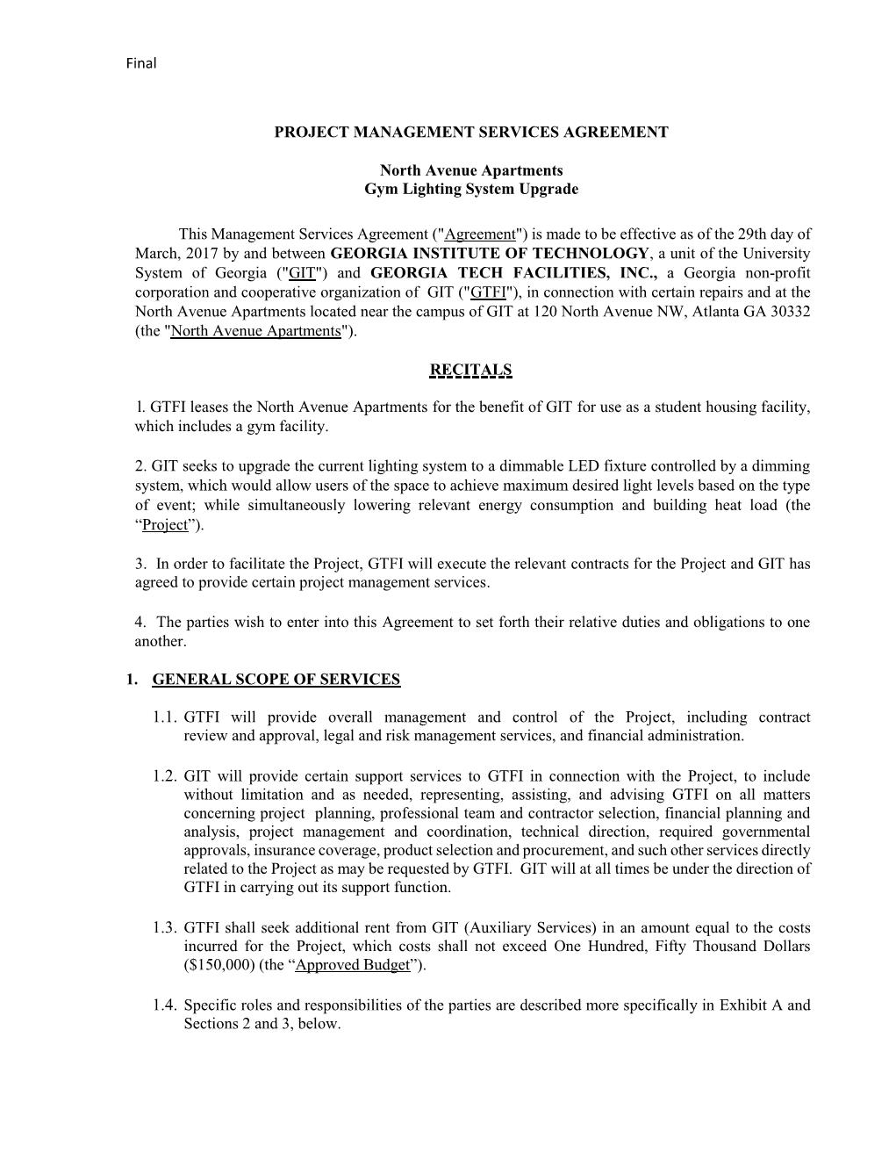
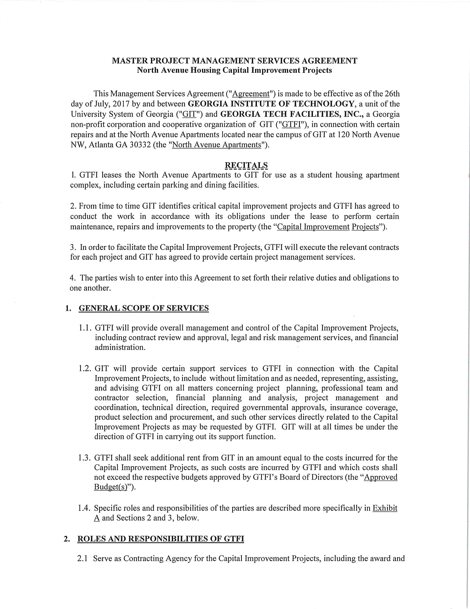
Georgia TECH Facilities INC. PMSA – Project MGMT AGREEEMENT

Slide 16
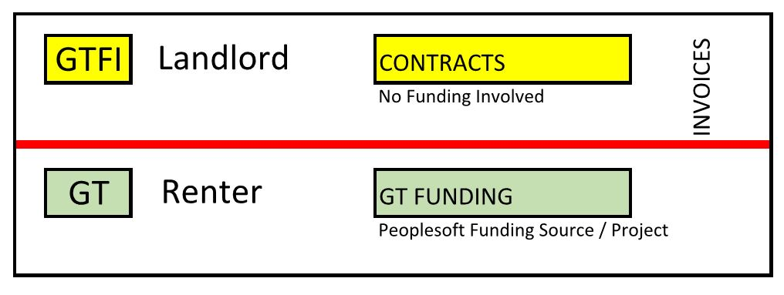
Georgia TECH Facilities INC. PMSA funding
GT PM manages project on behalf of GTFI through a PMSA.
Contracts are held by GTFI
GTFI (Landlord) pays invoices and may be reimbursed from designated project funds or applicable reserves.
A GT PeopleSoft funding source (PeopleSoft funding project) must be set up to receive invoices from GTFI. (Note: GT can only reimburse for legitimate costs incurred by GTFI at the specific direction of GT, as tenant.)

Slide 17
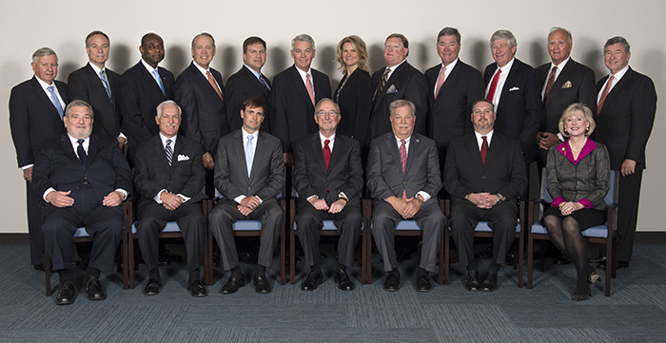
Georgia TECH Facilities INC. BOR ENGAGEMENT
The Board of Regents is engaged in PPV projects for:
Project approval >$1.0m construction cost
Oversight and design phase review of PPV CAP projects
Approval of PPV lease agreements and financing.
BOR PPV Process Guide - Located on forms website
BOR Real Estate / Facilities POC - Ron Reed, Director of Real Estate Ventures

Slide 18
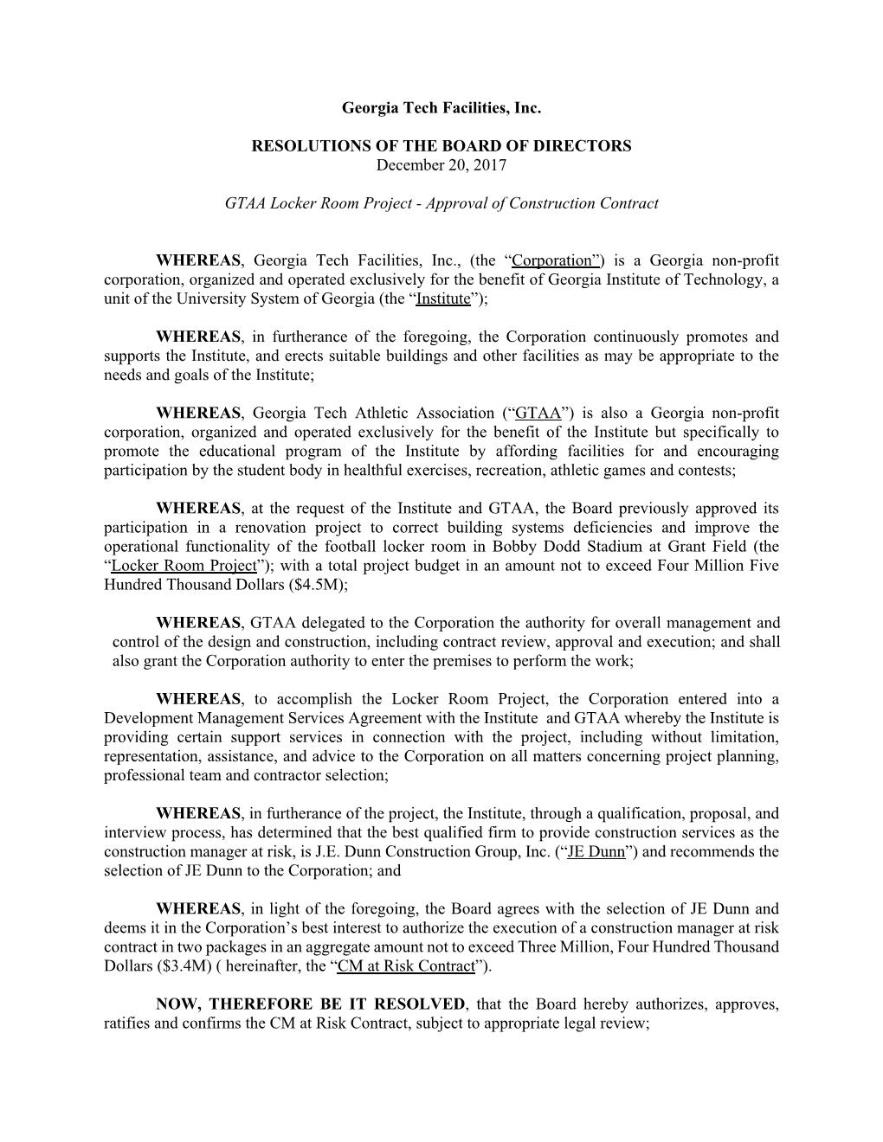
Georgia TECH Facilities INC. GTFI BOARD APPROVALS
The GTFI Board Typically Approves:
Project Authorization
DMSA or PMSA
Design contracts, Construction contracts, and key Consultant contracts (program manager).
Process for GTFI Board approval:
Resolutions and documents for Board approval are prepared by the Executive Director (Aisha Staley-Oliver), based on timely information provided by project managers.
Monthly board meetings are use for approvals.

Slide 19
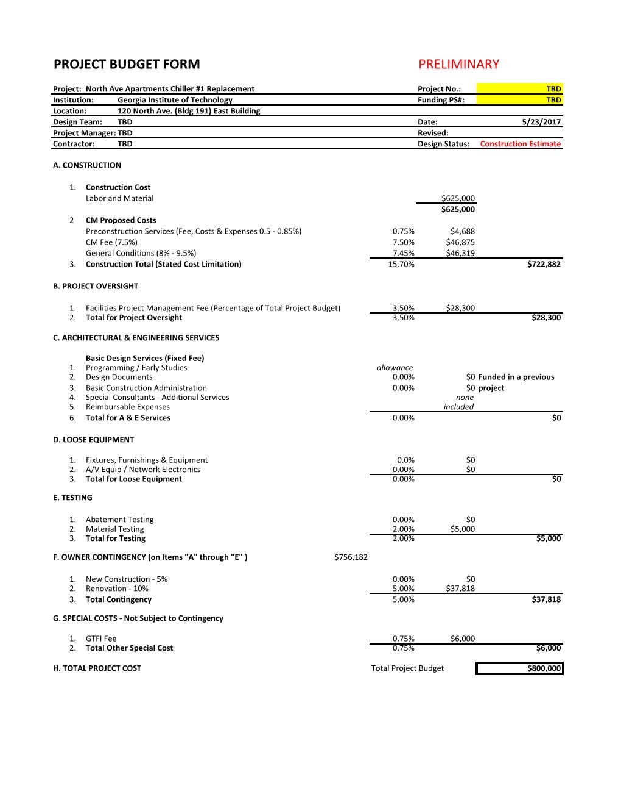
Georgia TECH Facilities INC. Budgeting – GTFi FEES
ALL GTFI projects are assessed a 0.75% (3/4 percent) fee against the Total Project Budget. GTFI fees are used to cover external audits, accounting charges, and required insurance.
The fee is charged as invoices are paid against GTFI funds and is a part of the Total Project Budget.
Legal Fees – Legal fees may also be charged as project costs.
Project managers should periodically request the GTFI accounting spreadsheet to ensure that they are capturing all costs in their cost projections.

Slide 20
Georgia TECH Facilities INC. Budgeting – Board Approvals
After a project is approved by the GTFI Board, the project budget should not be adjusted.
In order to manage this process on smaller projects, the project approvals should be completed in two parts:
- Approval of Design Fees
- Approval of Total Project Budget, based upon an executable construction cost (ready to contract).
This can extend small project timelines based upon Board meeting schedules. Building managers need to PLAN AHEAD.

Slide 21
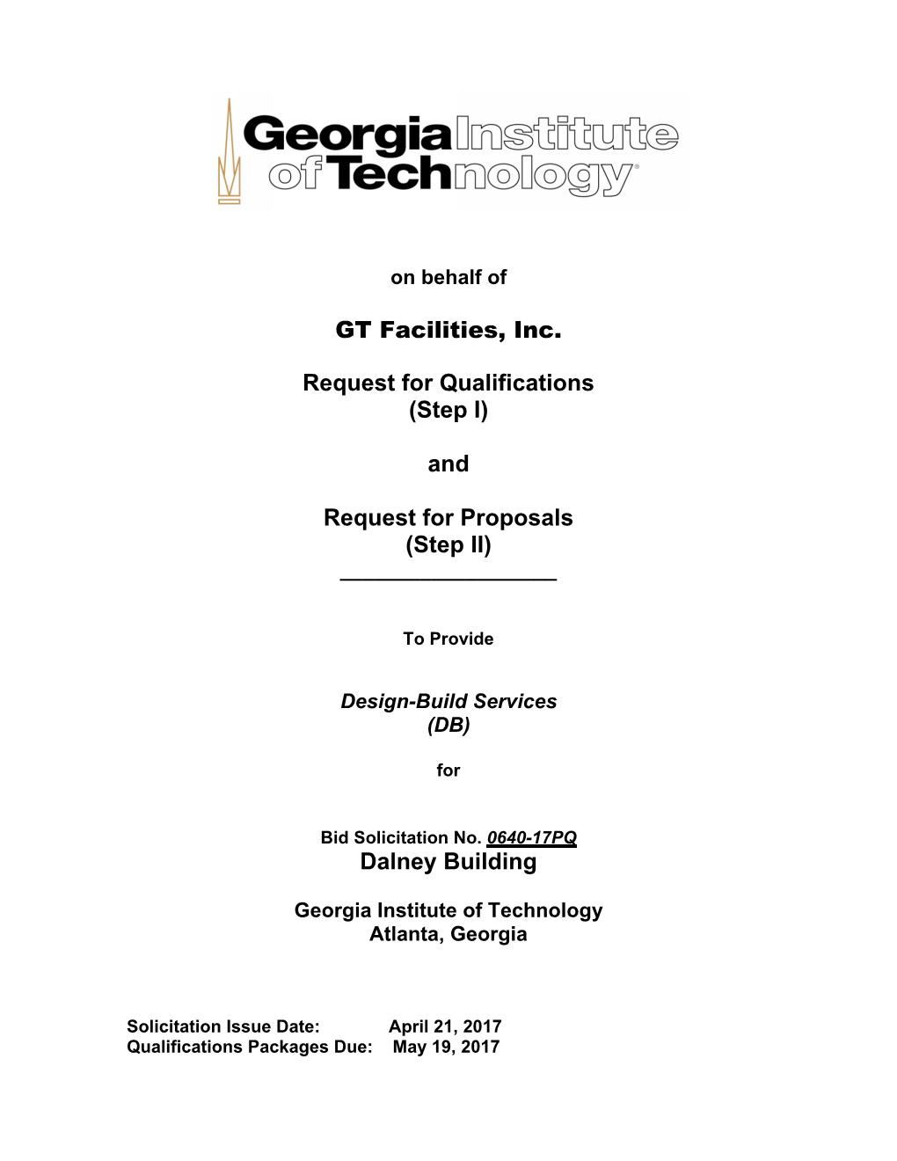
Georgia TECH Facilities INC. PROCUREMENT
When Facilities is engaged by a DMSA to manage GTFI project work, we utilize our standard procurement practices.
Projects are advertised and bid on the Georgia Procurement Registry using GTFI RFP/Q’s, where GTFI is the Owner.
We utilize Task Order contractors and IDIQ consultants, but the contract issued is an AIA contract with GTFI. The Task Order and IDIQ contract amounts must be logged against the IDIQ and Task Order base contract totals.

Slide 22
Georgia TECH Facilities INC. CONTRACTIng
GTFI utilizes AIA contracts and other custom contract templates.
The Executive Director (Aisha) executes all GTFI contracts. (GT Facilities EVP and BOR do not execute contracts!)
Contracts for DMSA (major projects >$1.0m) must be reviewed in detail by the Executive Director.
Contracts for PMSA (small projects in existing buildings <$1m) can be emailed for signature, provided the contract is based upon a pre-approved AIA template, to:ppv@gatech.edu

Slide 23
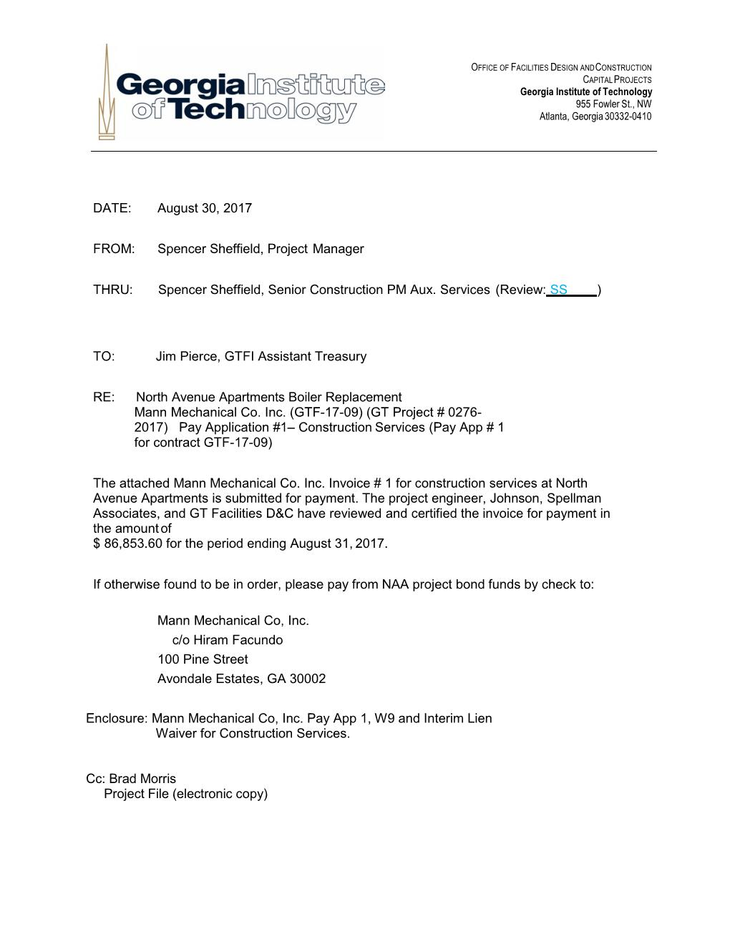
Georgia TECH Facilities INC. INVOICIng
GTFI pays invoices with mailed checks. Direct deposit is not available for vendors.
Email invoices to: ppv@gatech.edu
A cover memo should be included on all invoices – See Forms Website for template and example.
Interim and Final Lien Releases are required to be submitted for all GTFI Invoices for contractors.
A W9 Tax Form must be submitted with the first invoice for all vendors.
Copy the GT financial accountant for the customer on any pass through invoicing projects.

Slide 24
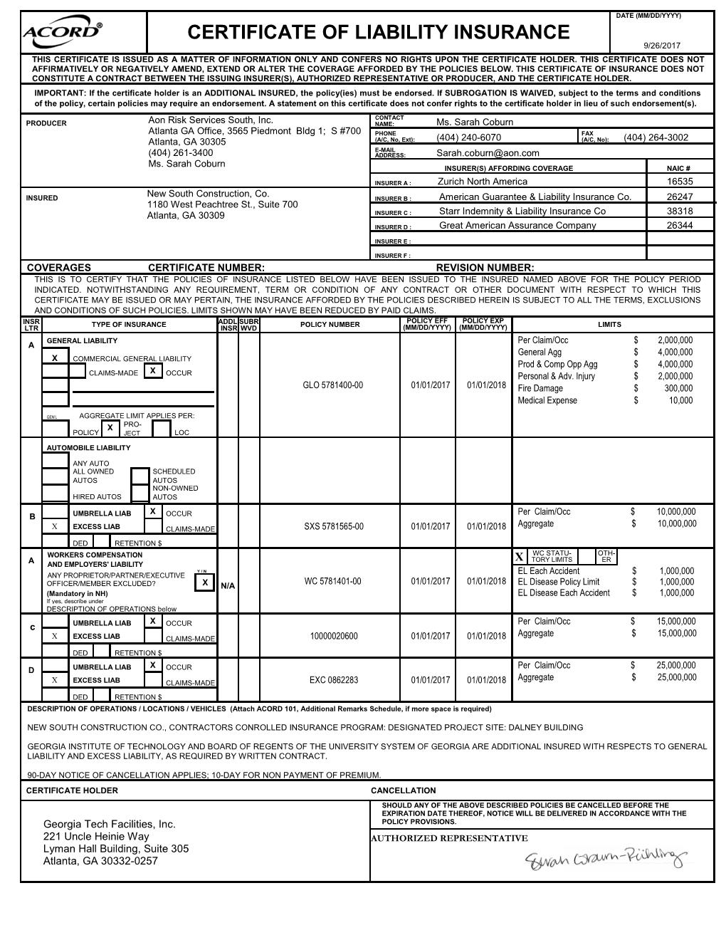
Georgia TECH Facilities INC. INSURANCE REQUIREMENTS
GTFI has different insurance requirements which are outlined in the contract by project.
Some differences include: GTFI is listed as a certificate holder, the limits may exceed BOR requirements, and GIT and BOR need to be listed as additional insured.
PM Responsibilities:
- Ensure that current certificates of insurance are on file.
- Ensure that insurance certificates are reviewed by GTFI before contracts are executed.

Slide 25
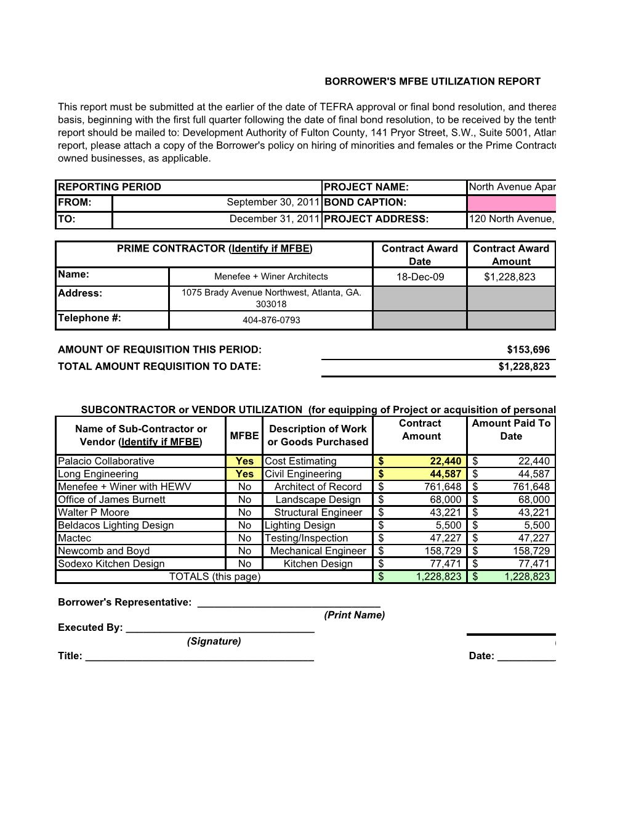
Georgia TECH Facilities INC. MFBE Utilization Reports
Some financing requires that the borrower provide a goal for MFBE (Minority and Female Business Enterprises.)
Project managers may be asked to report out on how the team is meeting targets in an MFBE Report submitted with each pay request.

Slide 26
Georgia TECH Facilities INC. RISKS for GTFI Projects
GTFI is an independent corporation (not state government) and assumes greater risks on PPV projects.
Contract risk must be carefully managed.
Insurance certificates and payment lien releases help protect GTFI from claims.
Building managers and project managers must plan ahead for GTFI projects – Approvals even on small projects can take a few months. The Board, ideally, prefers to know about projects a year in advance, or as early as possible (especially capital repairs.)
Project managers must keep careful track of project accounting. Accounting systems are not currently in place to ensure that projects are not being over-encumbered.

